Slide 1
Reinforced concrete structures
Unit – II
Limit State Design Method

Slide 2
Syllabus
INTRODUCTION TO LIMIT STATE DESIGN
Concept of limit state design
Characteristic loads
Characteristic strength
Partial load factor and material safety factors
Stress – Strain Curves
Assumptions
Stress Block Parameters
SINGLY AND DOUBLY REINFORCED BEAMS
Limit state analysis and design of Singly reinforced
and doubly reinforced beams.

Slide 3
Singly reinforced section
W kN / m
Compression
Tension

Slide 4
Stress-strain diagram of concrete
fck (Cube – 28 days of curing)
stress
0.67fck (strength of concrete in structure)
0.446fck (Design curve)
0.002
0.0035
strain

Slide 5
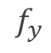
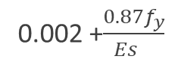
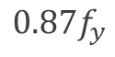
Stress-strain diagram of mild steel
Yield Plateau
stress
$$f_{y}$$
stress
$$0.87f_{y}$$
strain
Proof strain of 0.2% is recommended by IS 456
0.002 +$\frac{0.87f_{y}}{{Es}_{}}$
0.002
strain

Slide 6
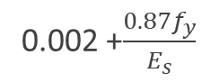
Assumptions of limit state method
The plane section before bending remains plane after bending.
Maximum strain in concrete is 0.0035
Maximum strain in steel is
Tensile strength of concrete is ignored.
0.002 +$\frac{0.87f_{y}}{E_{s}}$

Slide 7
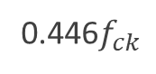
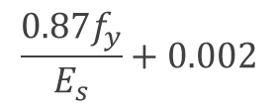
Stress block parameters
b
0.0035
0.446$f_{ck}$
C
d
D
T
$$\frac{0.87f_{y}}{E_{s}}+0.002$$
Strain
Diagram
Stress Diagram

Slide 8
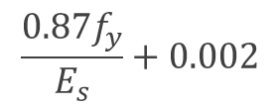
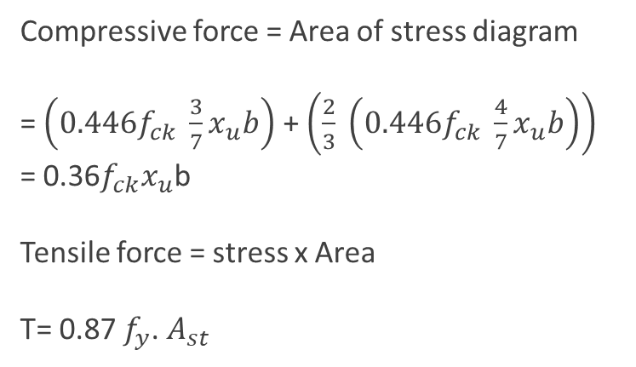
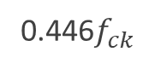
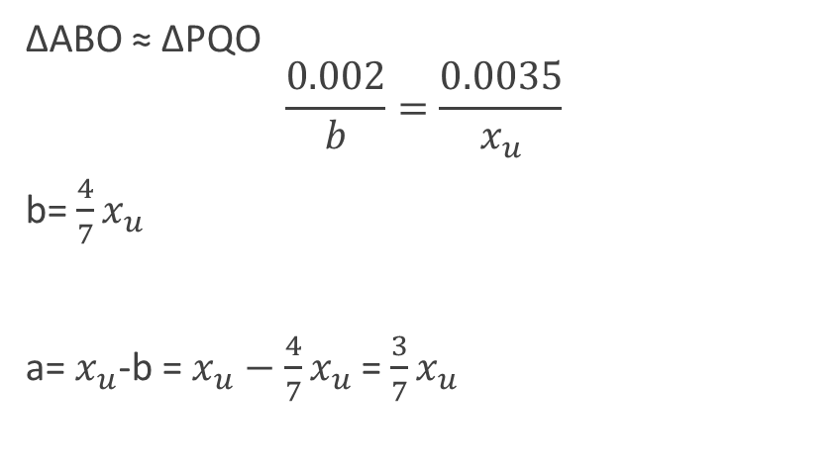
b
0.0035
0.446$f_{ck}$
C
d
D
T
$$\frac{0.87f_{y}}{E_{s}}+0.002$$
Strain
Diagram
Stress Diagram
ΔABO ≈ ΔPQO
$$\frac{0.002}{b}=\frac{0.0035}{x_{u}}$$
b= $\frac{4}{7}x_{u}$
a= $x_{u}$-b = $x_{u}−$ $\frac{4}{7}x_{u}$ = $\frac{3}{7}x_{u}$
Compressive force = Area of stress diagram
= $\left(0.446f_{ck} \frac{3}{7}x_{u}b\right)$ + $\left(\frac{2}{3} \left(0.446f_{ck} \frac{4}{7}x_{u}b\right)\right)$
= 0.36$f_{ck}x_{u}$b
Tensile force = stress x Area
T= 0.87 $f_{y}$. $A_{st}$

Slide 9
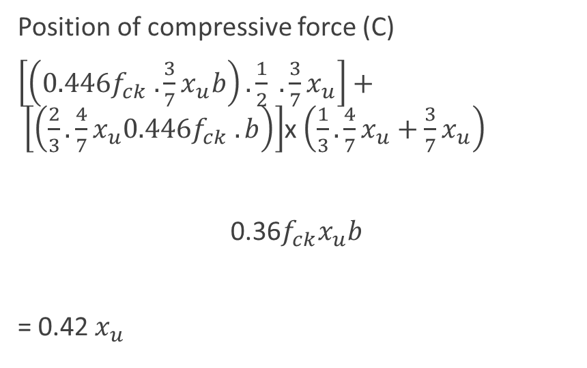
b
0.0035
0.446$f_{ck}$
C
d
D
T
$$\frac{0.87f_{y}}{E_{s}}+0.002$$
Strain
Diagram
Stress Diagram
Position of compressive force (C)
$\left[\left(0.446f_{ck} .\frac{3}{7}x_{u}b\right). \frac{1}{2} . \frac{3}{7}x_{u}\right]+ \left[\left(\frac{2}{3}.\frac{4}{7}x_{u}0.446f_{ck} .b\right)\right]$x $\left(\frac{1}{3}.\frac{4}{7}x_{u}+\frac{3}{7}x_{u}\right)$
0.36$f_{ck}x_{u}b$
= 0.42 $x_{u}$

Slide 10
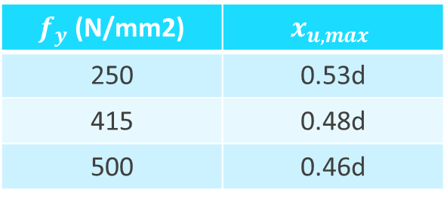
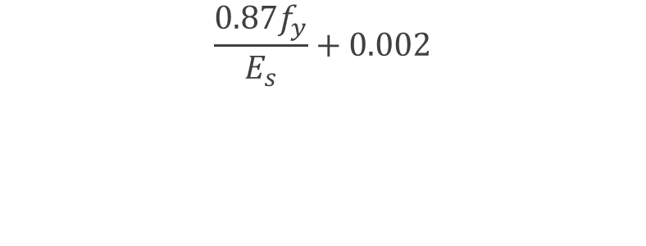
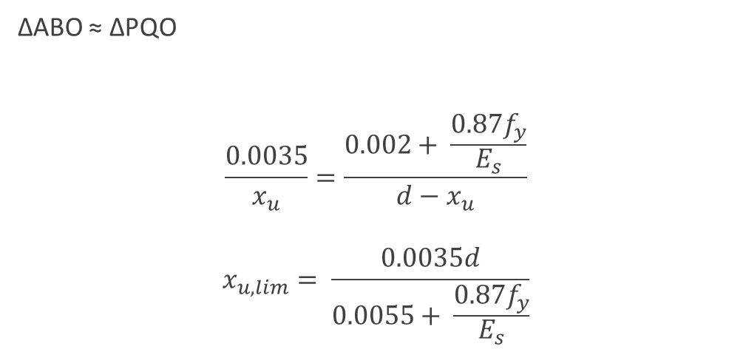
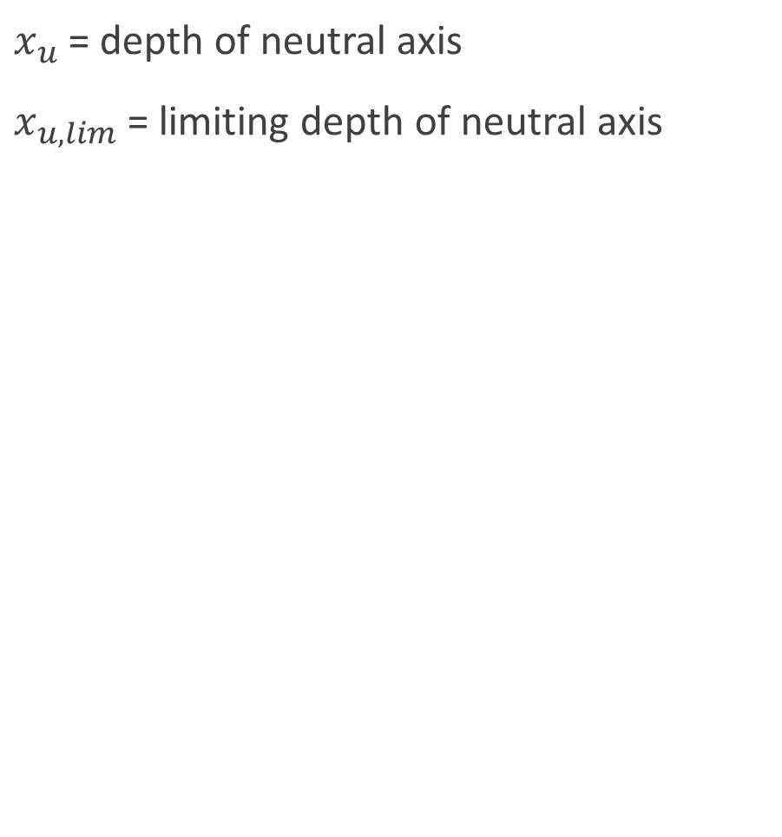
$x_{u}$ = depth of neutral axis
$x_{u,lim}$= limiting depth of neutral axis
0.0035
ΔABO ≈ ΔPQO
$$\frac{0.0035}{x_{u}}=\frac{0.002+ \frac{0.87f_{y}}{E_{s}}}{d−x_{u}}$$
$$x_{u,lim}= \frac{0.0035d}{0.0055+ \frac{0.87f_{y}}{E_{s}}}$$
d
$$\frac{0.87f_{y}}{E_{s}}+0.002$$
$f_{y}$ (N/mm2) | $$x_{u,max}$$
250 | 0.53d
415 | 0.48d
500 | 0.46d

Slide 11
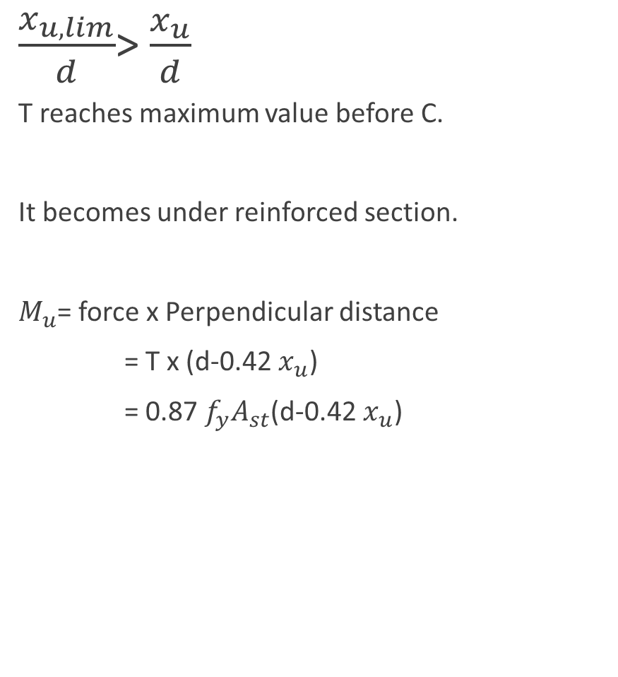
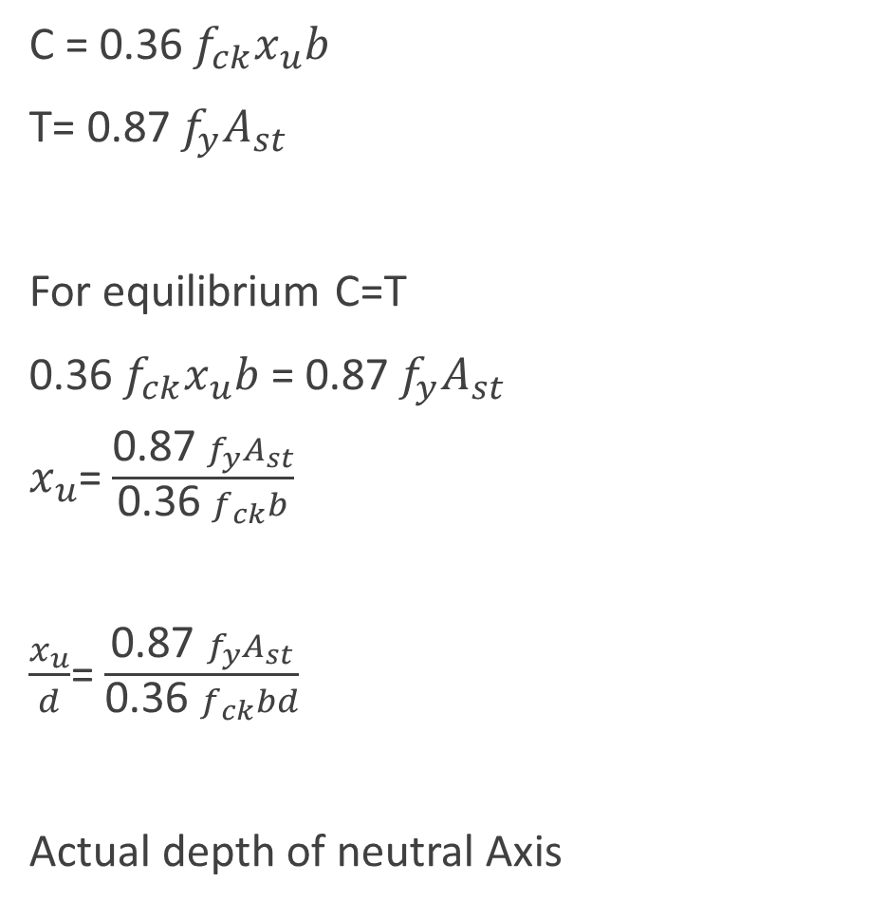
C = 0.36 $f_{ck}x_{u}b$
T= 0.87 $f_{y}A_{st}$
For equilibrium C=T
0.36 $f_{ck}x_{u}b$ = 0.87 $f_{y}A_{st}$
$x_{u}$= $\frac{\text{0.87 }f_{y}A_{st}}{\text{0.36 }f_{ck}b}$
$\frac{x_{u}}{d}$= $\frac{\text{0.87 }f_{y}A_{st}}{\text{0.36 }f_{ck}bd}$
Actual depth of neutral Axis
$\frac{x_{u,lim}}{d}$> $\frac{x_{u}}{d}$
T reaches maximum value before C.
It becomes under reinforced section.
$M_{u}$= force x Perpendicular distance
= T x (d-0.42 $x_{u}$)
= $\text{0.87 }f_{y}A_{st}$(d-0.42 $x_{u}$)

Slide 12
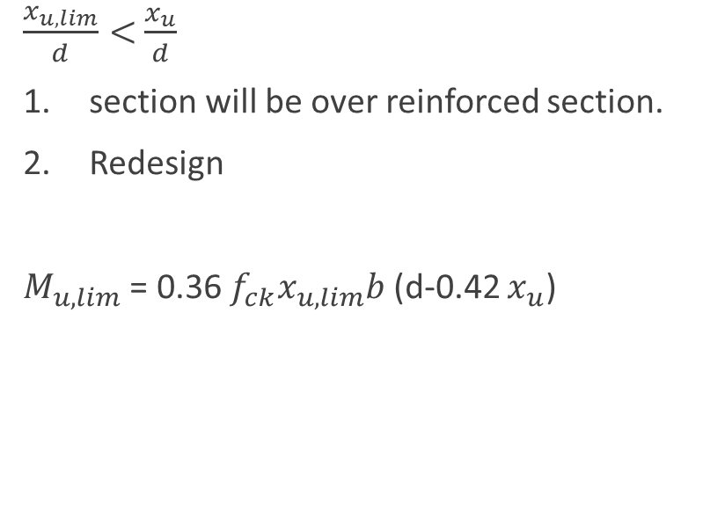
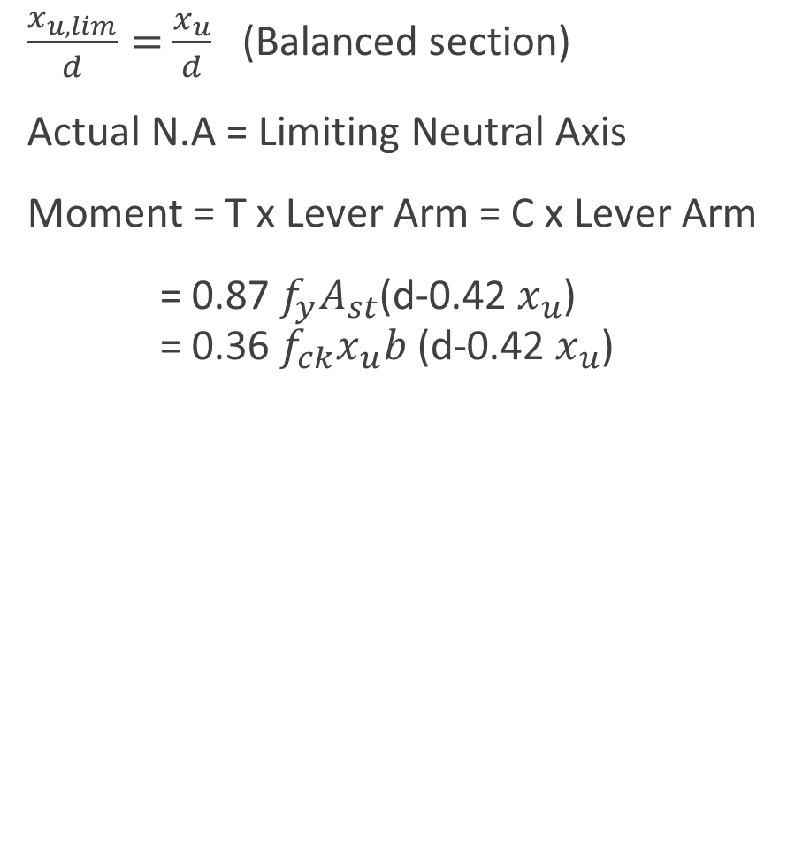
$\frac{x_{u,lim}}{d}=$ $\frac{x_{u}}{d}$ (Balanced section)
Actual N.A = Limiting Neutral Axis
Moment = T x Lever Arm = C x Lever Arm
= $\text{0.87 }f_{y}A_{st}$(d-0.42 $x_{u}$) = 0.36 $f_{ck}x_{u}b$ (d-0.42 $x_{u}$)
$\frac{x_{u,lim}}{d}<$ $\frac{x_{u}}{d}$
section will be over reinforced section.
Redesign
$M_{u,lim}$ = 0.36 $f_{ck}x_{u,lim}b$ (d-0.42 $x_{u}$)

Slide 13
Reinforced concrete structures
Unit – II
Limit State Design Method

Slide 14
Syllabus
INTRODUCTION TO LIMIT STATE DESIGN
Concept of limit state design
Characteristic loads
Characteristic strength
Partial load factor and material safety factors
Stress – Strain Curves
Assumptions
Stress Block Parameters
SINGLY AND DOUBLY REINFORCED BEAMS
Limit state analysis and design of Singly reinforced
and doubly reinforced beams.

Slide 15
Singly reinforced section
W kN / m
Compression
Tension

Slide 16
Stress-strain diagram of concrete
fck (Cube – 28 days of curing)
stress
0.67fck (strength of concrete in structure)
0.446fck (Design curve)
0.002
0.0035
strain

Slide 17
Stress-strain diagram of mild steel
Yield Plateau
stress
$$f_{y}$$
stress
$$0.87f_{y}$$
strain
Proof strain of 0.2% is recommended by IS 456
0.002 +$\frac{0.87f_{y}}{{Es}_{}}$
0.002
strain

Slide 18
Assumptions of limit state method
The plane section before bending remains plane after bending.
Maximum strain in concrete is 0.0035
Maximum strain in steel is
Tensile strength of concrete is ignored.
0.002 +$\frac{0.87f_{y}}{E_{s}}$

Slide 19
Stress block parameters
b
0.0035
0.446$f_{ck}$
C
d
D
T
$$\frac{0.87f_{y}}{E_{s}}+0.002$$
Strain
Diagram
Stress Diagram

Slide 20
b
0.0035
0.446$f_{ck}$
C
d
D
T
$$\frac{0.87f_{y}}{E_{s}}+0.002$$
Strain
Diagram
Stress Diagram
ΔABO ≈ ΔPQO
$$\frac{0.002}{b}=\frac{0.0035}{x_{u}}$$
b= $\frac{4}{7}x_{u}$
a= $x_{u}$-b = $x_{u}−$ $\frac{4}{7}x_{u}$ = $\frac{3}{7}x_{u}$
Compressive force = Area of stress diagram
= $\left(0.446f_{ck} \frac{3}{7}x_{u}b\right)$ + $\left(\frac{2}{3} \left(0.446f_{ck} \frac{4}{7}x_{u}b\right)\right)$
= 0.36$f_{ck}x_{u}$b
Tensile force = stress x Area
T= 0.87 $f_{y}$. $A_{st}$

Slide 21
b
0.0035
0.446$f_{ck}$
C
d
D
T
$$\frac{0.87f_{y}}{E_{s}}+0.002$$
Strain
Diagram
Stress Diagram
Position of compressive force (C)
$\left[\left(0.446f_{ck} .\frac{3}{7}x_{u}b\right). \frac{1}{2} . \frac{3}{7}x_{u}\right]+ \left[\left(\frac{2}{3}.\frac{4}{7}x_{u}0.446f_{ck} .b\right)\right]$x $\left(\frac{1}{3}.\frac{4}{7}x_{u}+\frac{3}{7}x_{u}\right)$
0.36$f_{ck}x_{u}b$
= 0.42 $x_{u}$

Slide 22
$x_{u}$ = depth of neutral axis
$x_{u,lim}$= limiting depth of neutral axis
0.0035
ΔABO ≈ ΔPQO
$$\frac{0.0035}{x_{u}}=\frac{0.002+ \frac{0.87f_{y}}{E_{s}}}{d−x_{u}}$$
$$x_{u,lim}= \frac{0.0035d}{0.0055+ \frac{0.87f_{y}}{E_{s}}}$$
d
$$\frac{0.87f_{y}}{E_{s}}+0.002$$
$f_{y}$ (N/mm2) | $$x_{u,max}$$
250 | 0.53d
415 | 0.48d
500 | 0.46d

Slide 23
C = 0.36 $f_{ck}x_{u}b$
T= 0.87 $f_{y}A_{st}$
For equilibrium C=T
0.36 $f_{ck}x_{u}b$ = 0.87 $f_{y}A_{st}$
$x_{u}$= $\frac{\text{0.87 }f_{y}A_{st}}{\text{0.36 }f_{ck}b}$
$\frac{x_{u}}{d}$= $\frac{\text{0.87 }f_{y}A_{st}}{\text{0.36 }f_{ck}bd}$
Actual depth of neutral Axis
$\frac{x_{u,lim}}{d}$> $\frac{x_{u}}{d}$
T reaches maximum value before C.
It becomes under reinforced section.
$M_{u}$= force x Perpendicular distance
= T x (d-0.42 $x_{u}$)
= $\text{0.87 }f_{y}A_{st}$(d-0.42 $x_{u}$)

Slide 24
$\frac{x_{u,lim}}{d}=$ $\frac{x_{u}}{d}$ (Balanced section)
Actual N.A = Limiting Neutral Axis
Moment = T x Lever Arm = C x Lever Arm
= $\text{0.87 }f_{y}A_{st}$(d-0.42 $x_{u}$) = 0.36 $f_{ck}x_{u}b$ (d-0.42 $x_{u}$)
$\frac{x_{u,lim}}{d}<$ $\frac{x_{u}}{d}$
section will be over reinforced section.
Redesign
$M_{u,lim}$ = 0.36 $f_{ck}x_{u,lim}b$ (d-0.42 $x_{u}$)

Slide 25
Reinforced concrete structures
Unit – II
Limit State Design Method

Slide 26
Syllabus
INTRODUCTION TO LIMIT STATE DESIGN
Concept of limit state design
Characteristic loads
Characteristic strength
Partial load factor and material safety factors
Stress – Strain Curves
Assumptions
Stress Block Parameters
SINGLY AND DOUBLY REINFORCED BEAMS
Limit state analysis and design of Singly reinforced
and doubly reinforced beams.

Slide 27
Contents
Analysis of a section
Design of a section

Slide 28
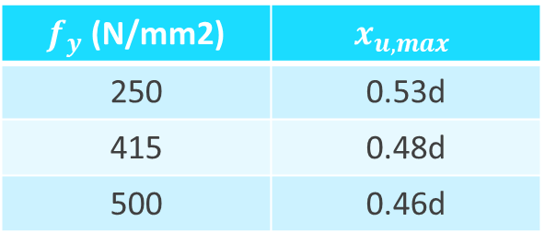
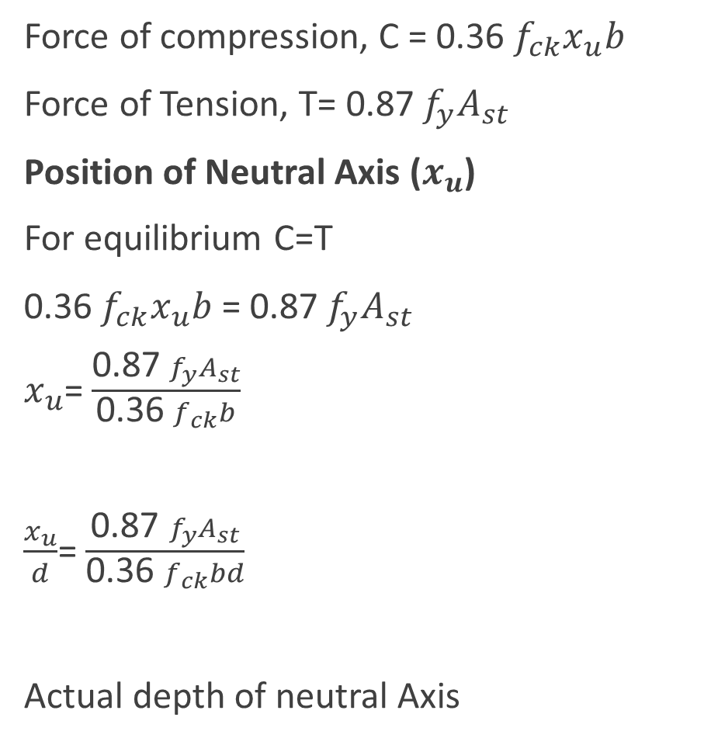
Analysis of singly reinforced section
Force of compression, C = 0.36 $f_{ck}x_{u}b$
Force of Tension, T= 0.87 $f_{y}A_{st}$
Position of Neutral Axis ($x_{u}$)
For equilibrium C=T
0.36 $f_{ck}x_{u}b$ = 0.87 $f_{y}A_{st}$
$x_{u}$= $\frac{\text{0.87 }f_{y}A_{st}}{\text{0.36 }f_{ck}b}$
$\frac{x_{u}}{d}$= $\frac{\text{0.87 }f_{y}A_{st}}{\text{0.36 }f_{ck}bd}$
Actual depth of neutral Axis
Maximum depth of neutral axis
$f_{y}$ (N/mm2) | $$x_{u,max}$$
250 | 0.53d
415 | 0.48d
500 | 0.46d

Slide 29
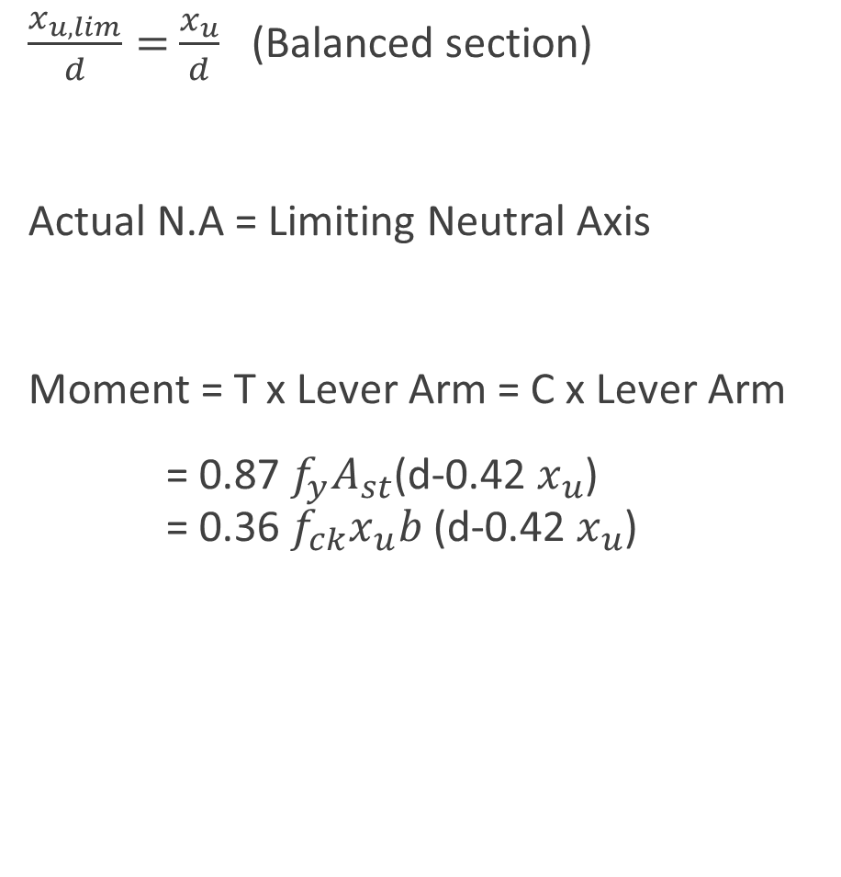
Balanced section
$\frac{x_{u,lim}}{d}=$ $\frac{x_{u}}{d}$ (Balanced section)
Actual N.A = Limiting Neutral Axis
Moment = T x Lever Arm = C x Lever Arm
= $\text{0.87 }f_{y}A_{st}$(d-0.42 $x_{u}$) = 0.36 $f_{ck}x_{u}b$ (d-0.42 $x_{u}$)

Slide 30
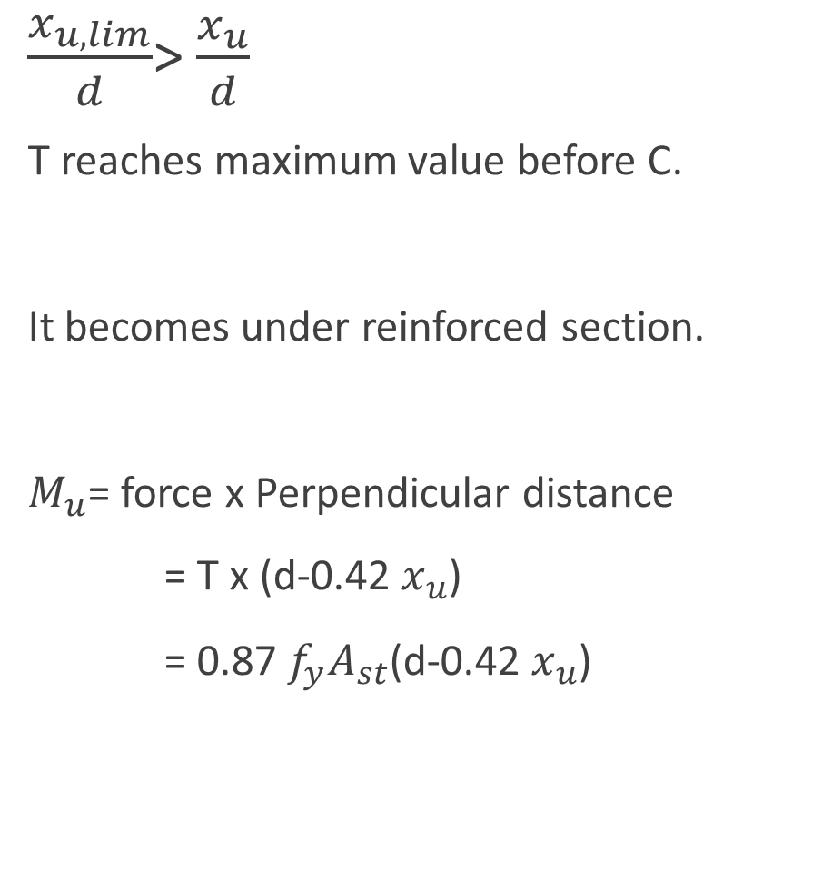
Limiting value of tension steel and moment of resistance
$\frac{x_{u,lim}}{d}$> $\frac{x_{u}}{d}$
T reaches maximum value before C.
It becomes under reinforced section.
$M_{u}$= force x Perpendicular distance
= T x (d-0.42 $x_{u}$)
= $\text{0.87 }f_{y}A_{st}$(d-0.42 $x_{u}$)
When limiting neutral axis is greater than the actual neutral axis.
Continued….

Slide 31
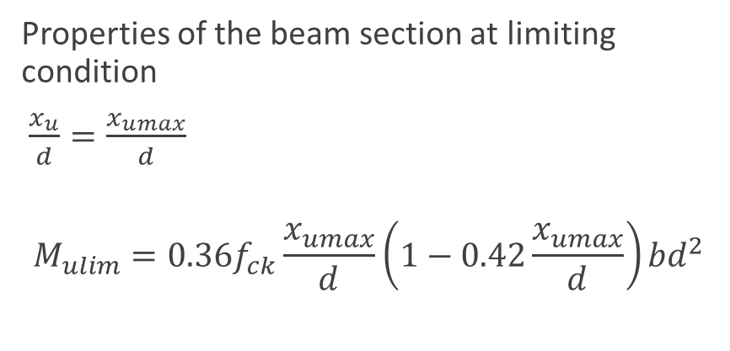
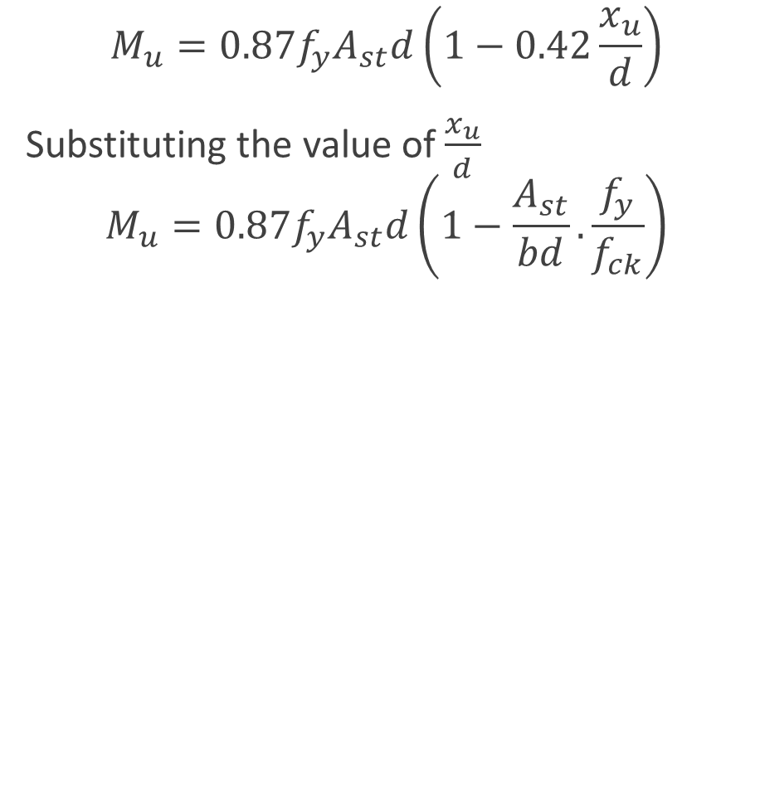
$$M_{u}=0.87f_{y}A_{st}d\left(1−0.42\frac{x_{u}}{d}\right)$$
Substituting the value of$\frac{x_{u}}{d}$
$$M_{u}=0.87f_{y}A_{st}d\left(1−\frac{A_{st}}{bd}.\frac{f_{y}}{f_{ck}}\right)$$
Properties of the beam section at limiting condition
$\frac{x_{u}}{d}=\frac{x_{umax}}{d}$
$$M_{ulim}=0.36f_{ck}\frac{x_{umax}}{d}\left(1−0.42\frac{x_{umax}}{d}\right)bd^{2}$$

Slide 32
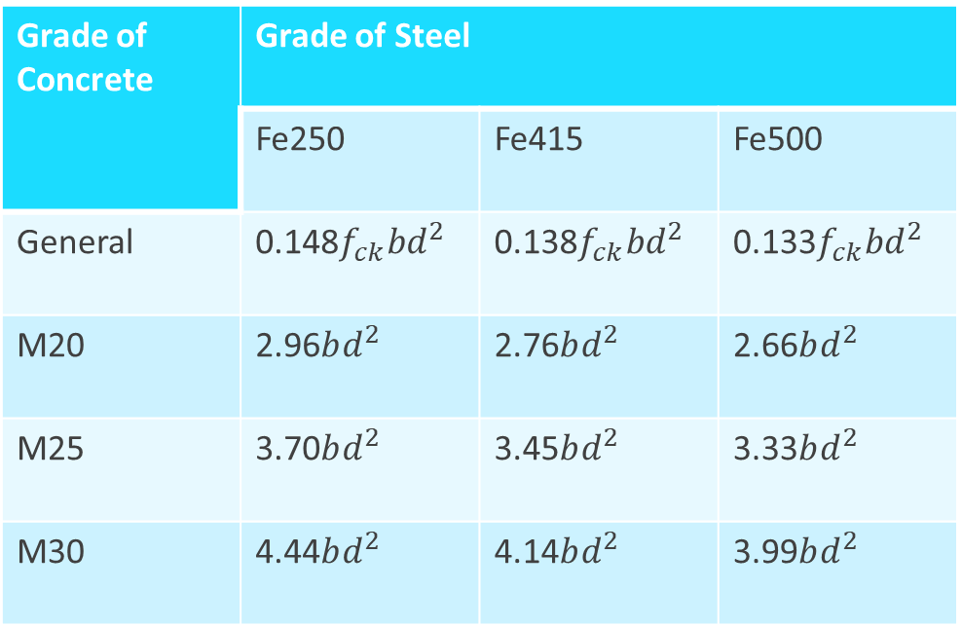
Grade of Concrete | Grade of Steel
 | Fe250 | Fe415 | Fe500
General | 0.148$f_{ck}bd^{2}$ | 0.138$f_{ck}bd^{2}$ | 0.133$f_{ck}bd^{2}$
M20 | 2.96$bd^{2}$ | 2.76$bd^{2}$ | 2.66$bd^{2}$
M25 | 3.70$bd^{2}$ | 3.45$bd^{2}$ | 3.33$bd^{2}$
M30 | 4.44$bd^{2}$ | 4.14$bd^{2}$ | 3.99$bd^{2}$
Limiting moment of resistance values, Nmm

Slide 33
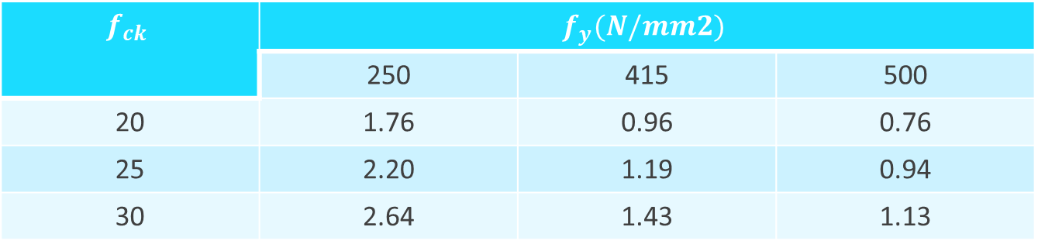
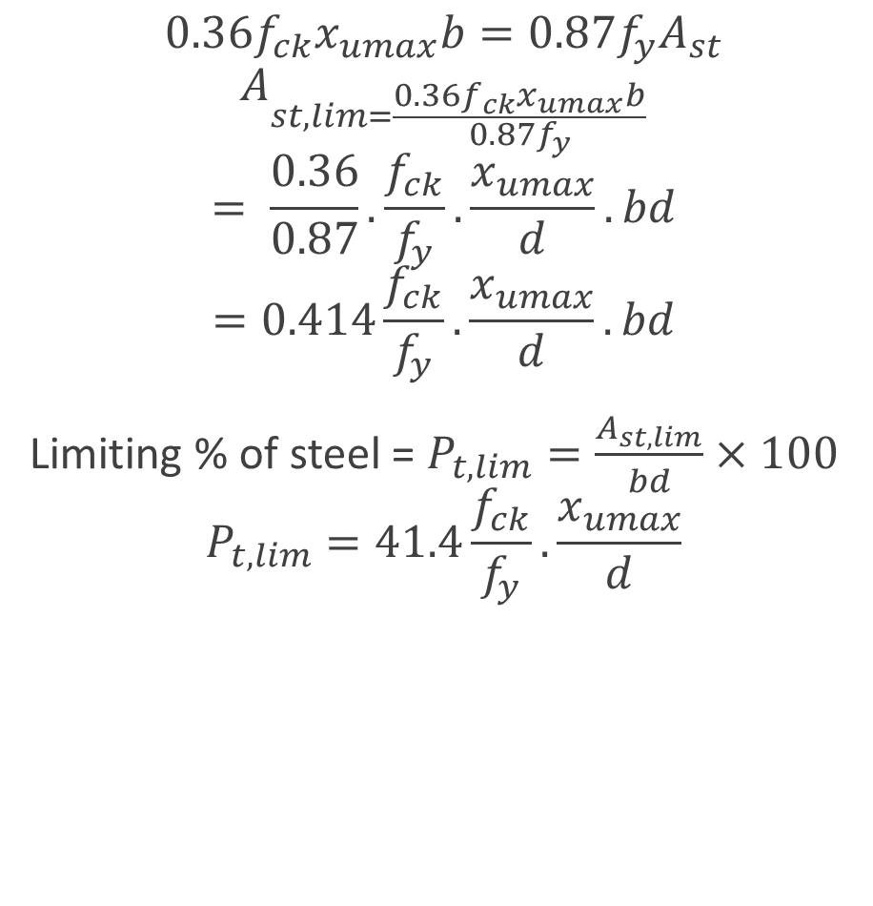
Percentage of tensile reinforcement
$$0.36f_{ck}x_{umax}b=0.87f_{y}A_{st}$$
$$A_{st,lim=\frac{0.36f_{ck}x_{umax}b}{0.87f_{y}}}$$
$$= \frac{0.36}{0.87}.\frac{f_{ck}}{f_{y}}.\frac{x_{umax}}{d}.bd$$
$$=0.414\frac{f_{ck}}{f_{y}}.\frac{x_{umax}}{d}.bd$$
Limiting % of steel = $P_{t,lim}=\frac{A_{st,lim}}{bd}×100$
$$P_{t,lim}=41.4\frac{f_{ck}}{f_{y}}.\frac{x_{umax}}{d}$$
The percentage of tensile reinforcement corresponding to limiting condition.
$$f_{ck}$$ | $$f_{y}(N/mm2)$$
 | 250 | 415 | 500
20 | 1.76 | 0.96 | 0.76
25 | 2.20 | 1.19 | 0.94
30 | 2.64 | 1.43 | 1.13

Slide 34
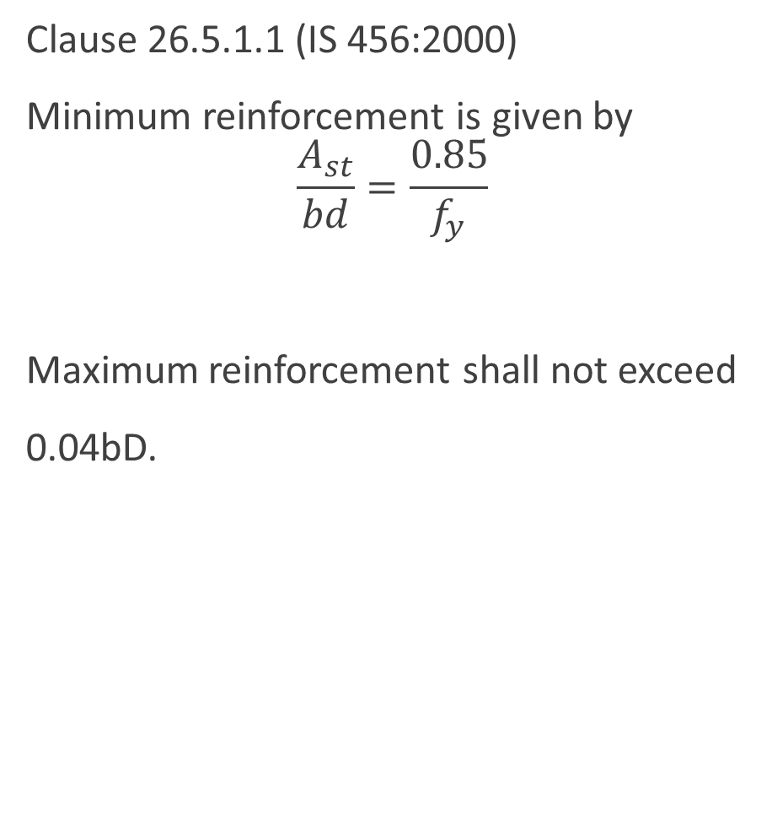
Clause 26.5.1.1 (IS 456:2000)
Minimum reinforcement is given by
$$\frac{A_{st}}{bd}=\frac{0.85}{f_{y}}$$
Maximum reinforcement shall not exceed
0.04bD.
Minimum and Maximum Tensile Reinforcement

Slide 35
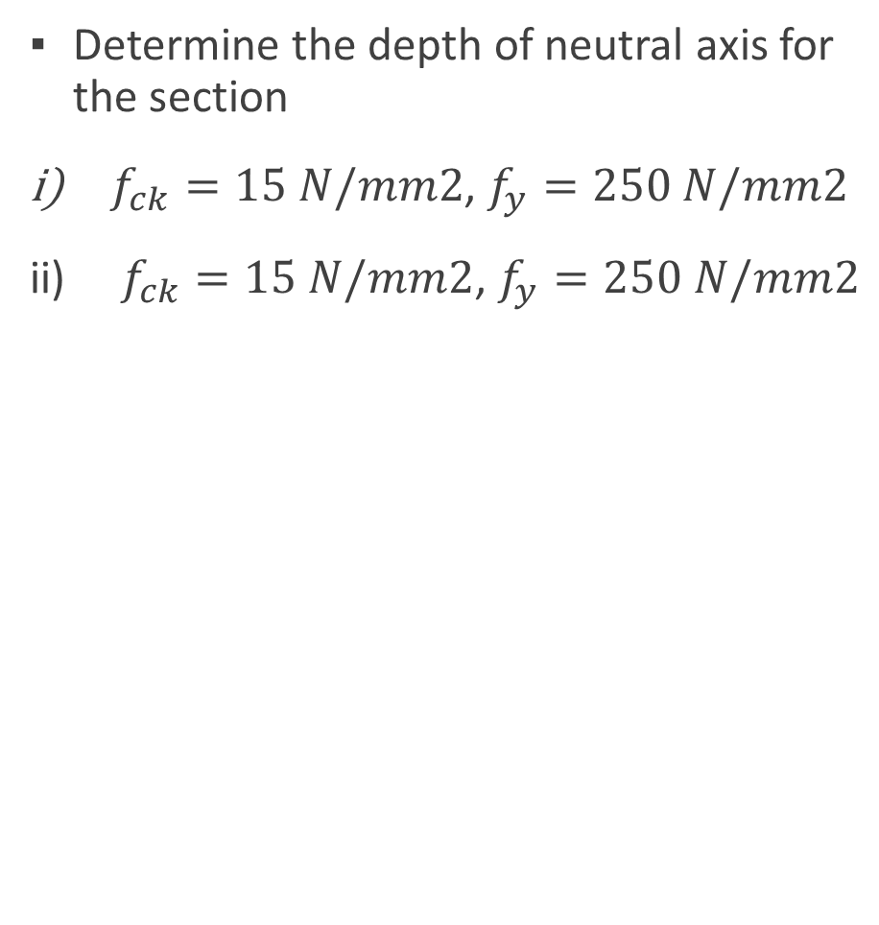
problems
Determine the depth of neutral axis for the section
$f_{ck}=15 N/mm2$, $f_{y}=250 N/mm2$
$f_{ck}=15 N/mm2$, $f_{y}=250 N/mm2$
200
x
400
3-20Ø
50

Slide 36
Reinforced concrete structures
Unit – II
Limit State Design Method

Slide 37
Syllabus
INTRODUCTION TO LIMIT STATE DESIGN
Concept of limit state design
Characteristic loads
Characteristic strength
Partial load factor and material safety factors
Stress – Strain Curves
Assumptions
Stress Block Parameters
SINGLY AND DOUBLY REINFORCED BEAMS
Limit state analysis and design of Singly reinforced
and doubly reinforced beams.

Slide 38
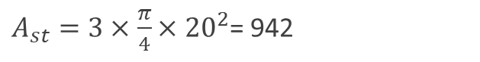
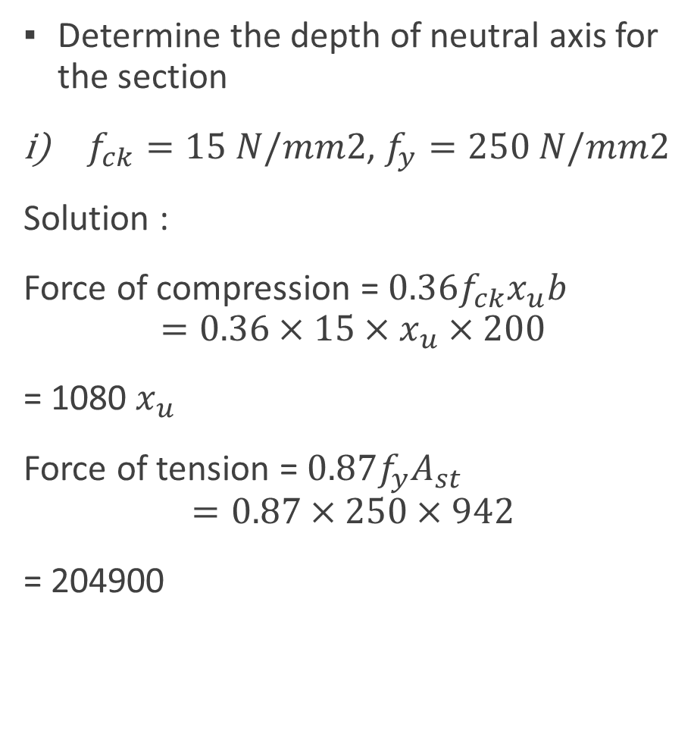
problems
Determine the depth of neutral axis for the section
$f_{ck}=15 N/mm2$, $f_{y}=250 N/mm2$
Solution :
Force of compression = $0.36f_{ck}x_{u}b$
$$=0.36×15×x_{u}×200$$
= 1080 $x_{u}$
Force of tension = $0.87f_{y}A_{st}$
$$=0.87×250×942$$
= 204900
200
x
400
3-20Ø
50
$A_{st}=3×\frac{π}{4}×{20}^{2}$= 942

Slide 39
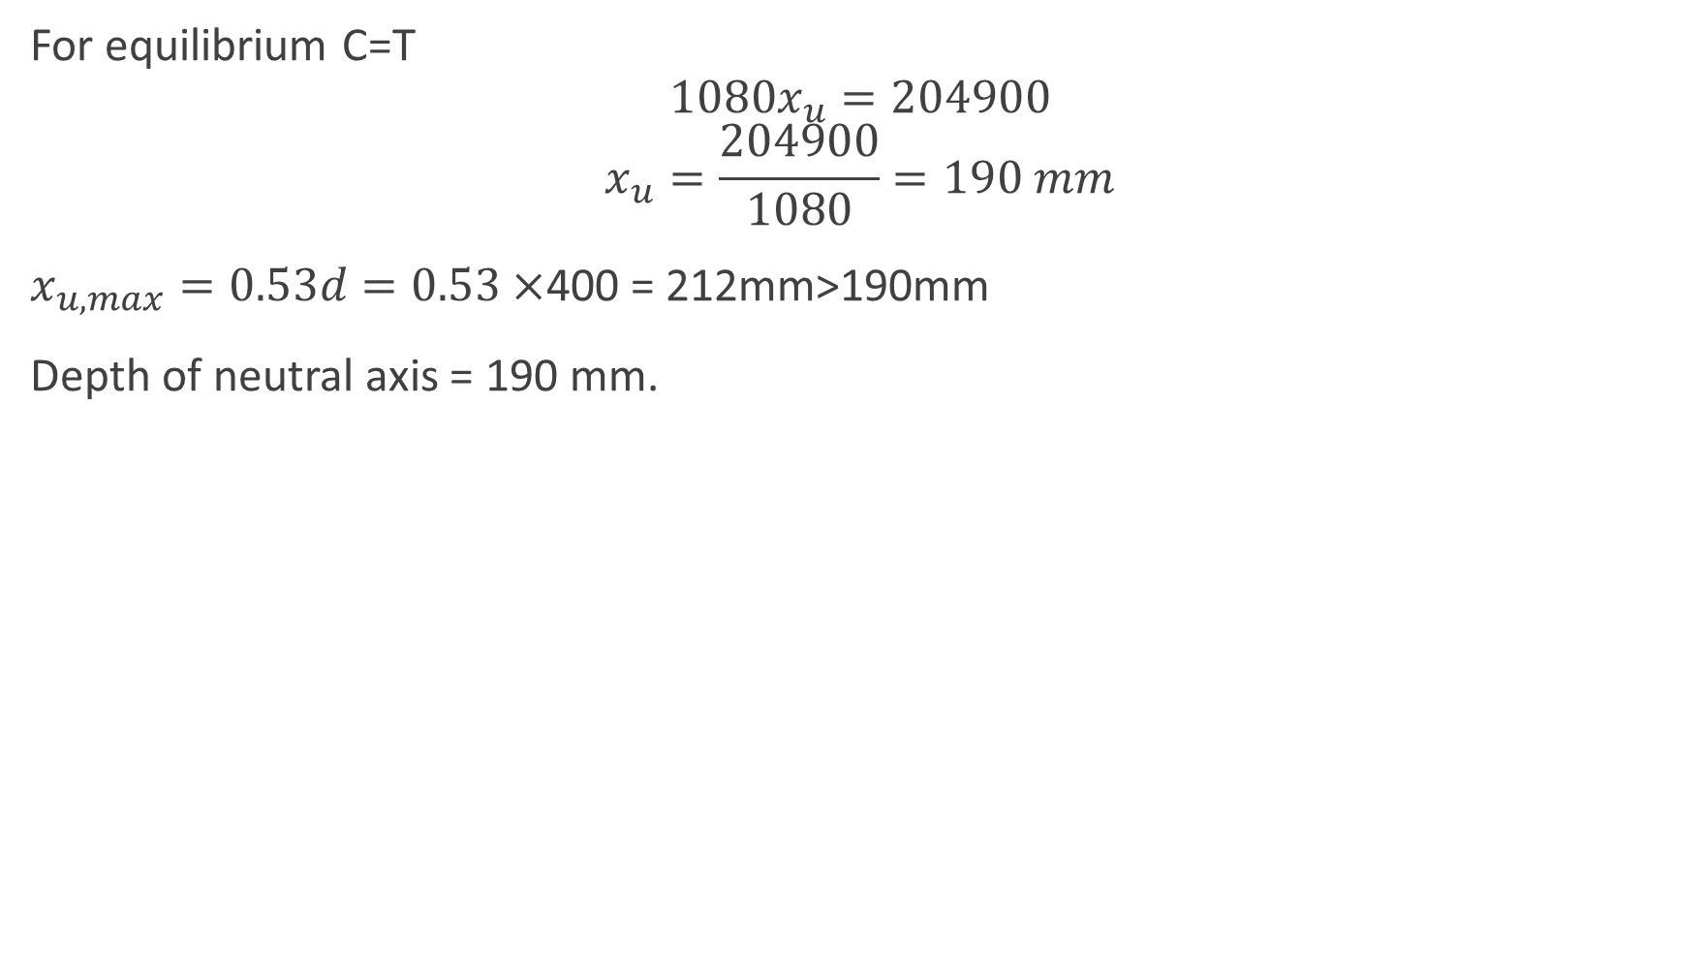
For equilibrium C=T
$$1080x_{u}=204900$$
$$x_{u}=\frac{204900}{1080}=190 mm$$
$x_{u,max}=0.53d=0.53×$400 = 212mm>190mm
Depth of neutral axis = 190 mm.

Slide 40
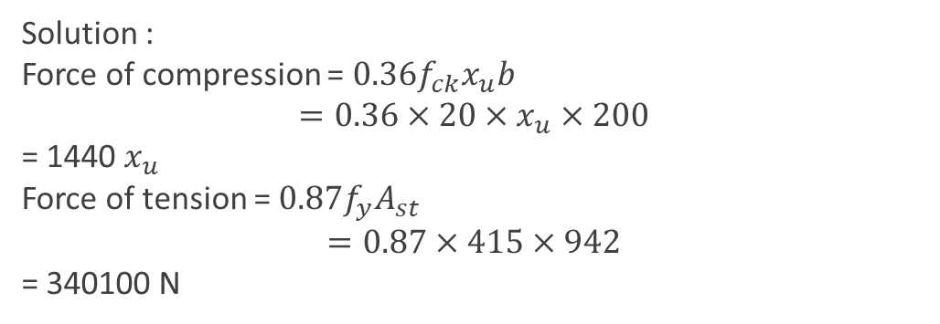
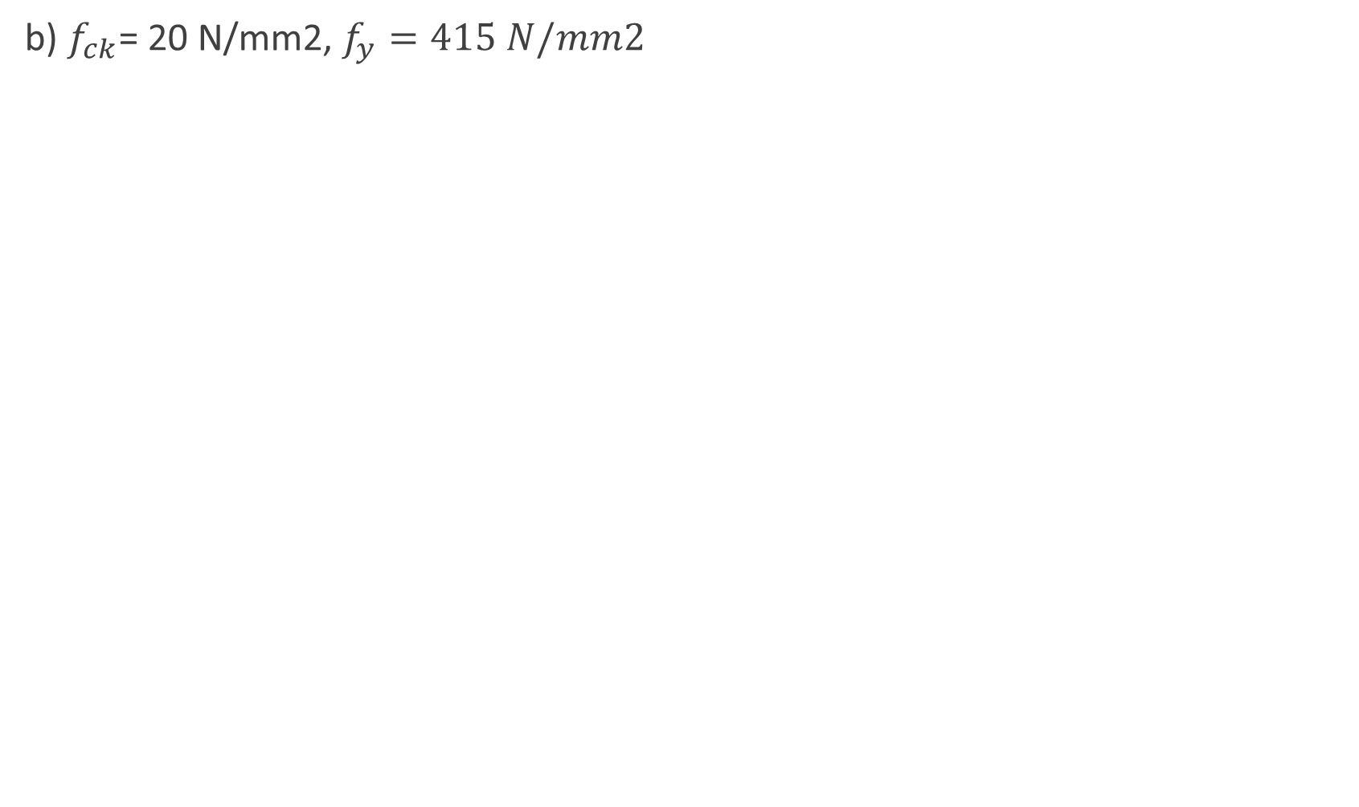
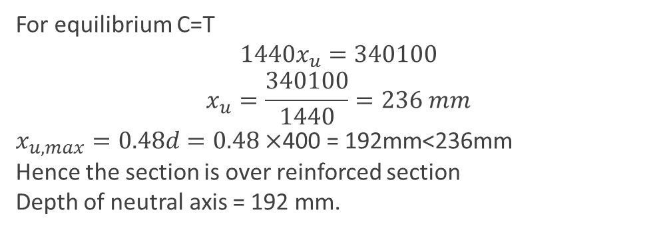
200
b) $f_{ck}$= 20 N/mm2, $f_{y}=415 N/mm2$
x
Solution :
Force of compression = $0.36f_{ck}x_{u}b$
$$=0.36×20×x_{u}×200$$
= 1440 $x_{u}$
Force of tension = $0.87f_{y}A_{st}$
$$=0.87×415×942$$
= 340100 N
400
3-20Ø
50
For equilibrium C=T
$$1440x_{u}=340100$$
$$x_{u}=\frac{340100}{1440}=236 mm$$
$x_{u,max}=0.48d=0.48×$400 = 192mm<236mm
Hence the section is over reinforced section
Depth of neutral axis = 192 mm.

Slide 41
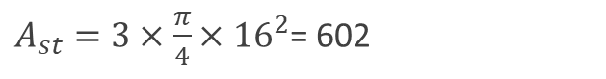
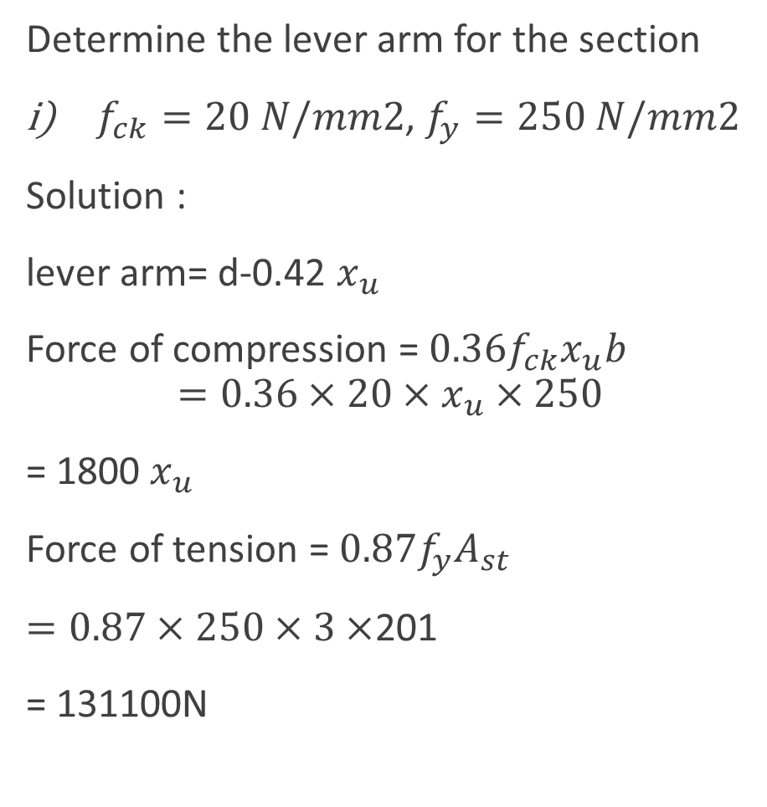
Determine the lever arm for the section
$f_{ck}=20 N/mm2$, $f_{y}=250 N/mm2$
Solution :
lever arm= d-0.42 $x_{u}$
Force of compression = $0.36f_{ck}x_{u}b$
$$=0.36×20×x_{u}×250$$
= 1800 $x_{u}$
Force of tension = $0.87f_{y}A_{st}$
$=0.87×250×3×$201
= 131100N
250
x
360
3-16Ø
40
$A_{st}=3×\frac{π}{4}×{16}^{2}$= 602

Slide 42
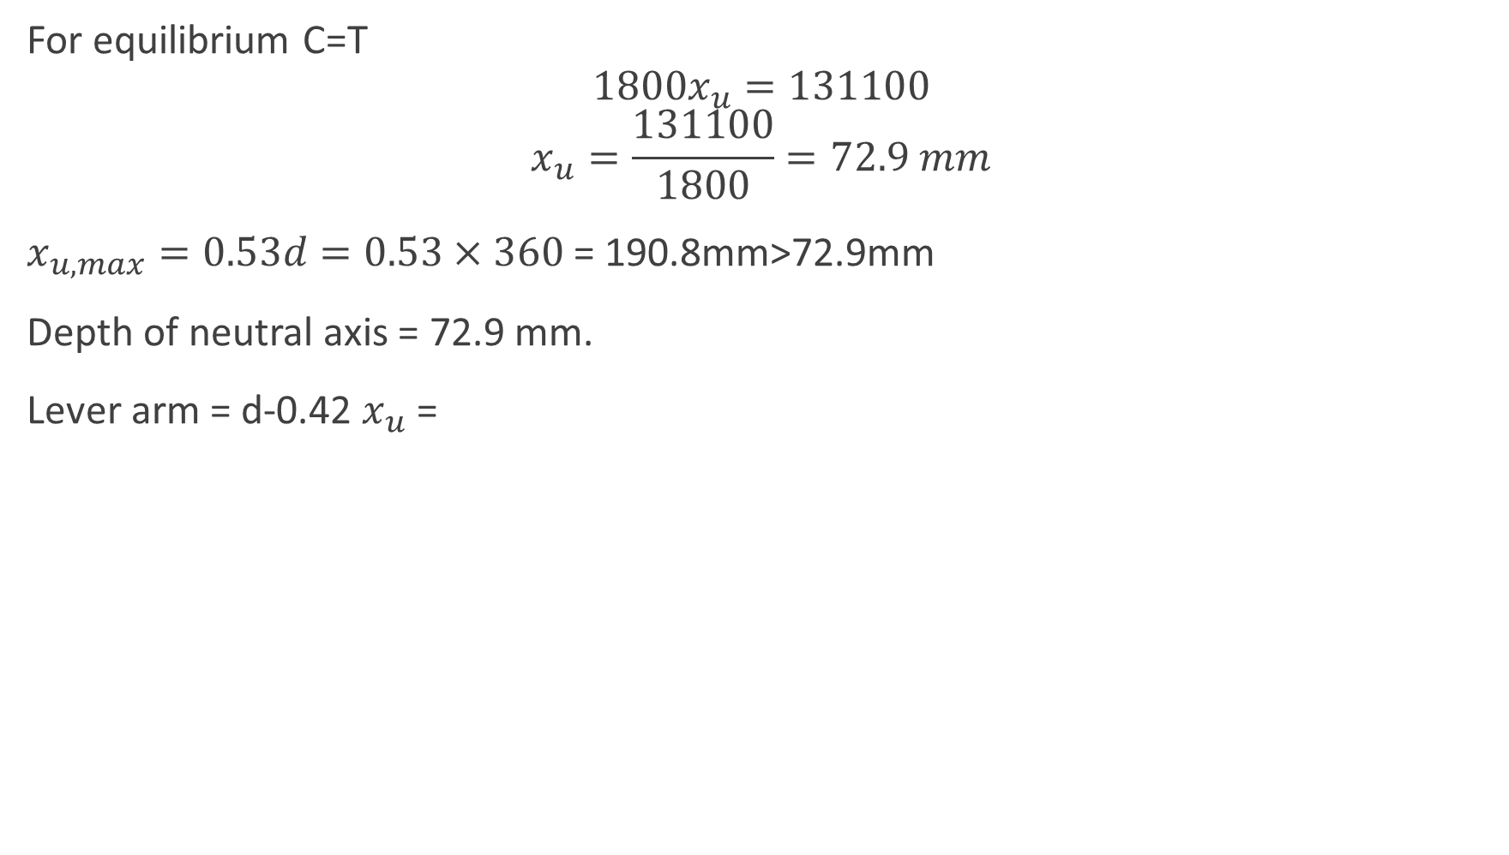
For equilibrium C=T
$$1800x_{u}=131100$$
$$x_{u}=\frac{131100}{1800}=72.9 mm$$
$x_{u,max}=0.53d=0.53×360$ = 190.8mm>72.9mm
Depth of neutral axis = 72.9 mm.
Lever arm = d-0.42 $x_{u}$ =

Slide 43
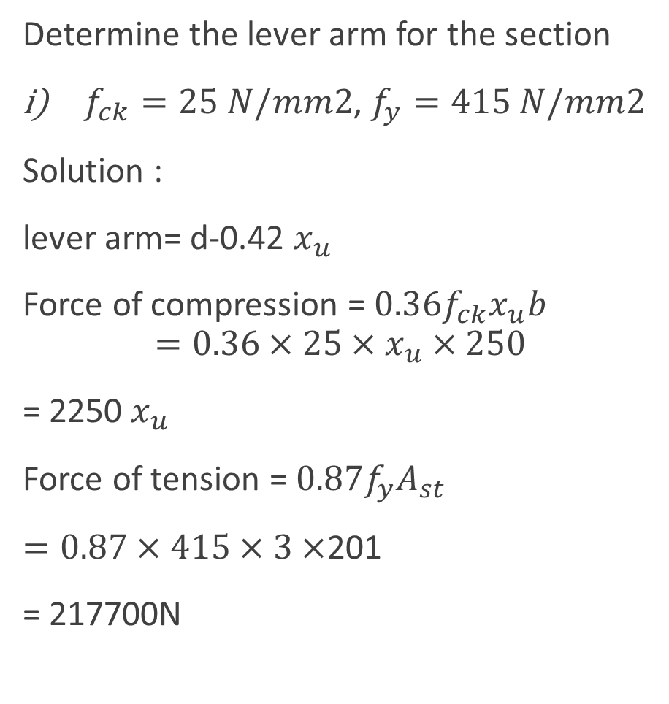
Determine the lever arm for the section
$f_{ck}=25 N/mm2$, $f_{y}=415 N/mm2$
Solution :
lever arm= d-0.42 $x_{u}$
Force of compression = $0.36f_{ck}x_{u}b$
$$=0.36×25×x_{u}×250$$
= 2250 $x_{u}$
Force of tension = $0.87f_{y}A_{st}$
$=0.87×415×3×$201
= 217700N
250
x
360
3-16Ø
40
$A_{st}=3×\frac{π}{4}×{16}^{2}$= 602

Slide 44
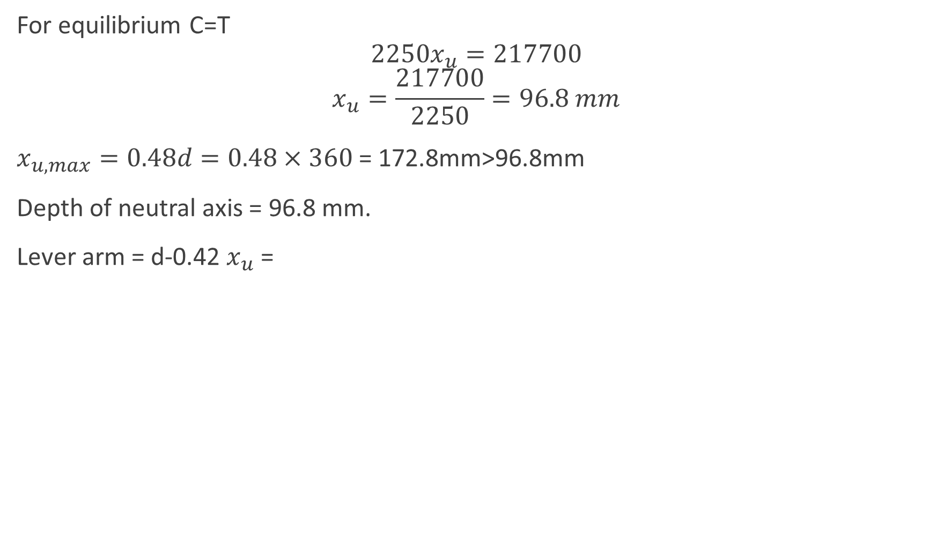
For equilibrium C=T
$$2250x_{u}=217700$$
$$x_{u}=\frac{217700}{2250}=96.8 mm$$
$x_{u,max}=0.48d=0.48×360$ = 172.8mm>96.8mm
Depth of neutral axis = 96.8 mm.
Lever arm = d-0.42 $x_{u}$ =

Slide 45
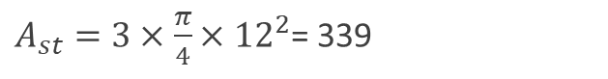
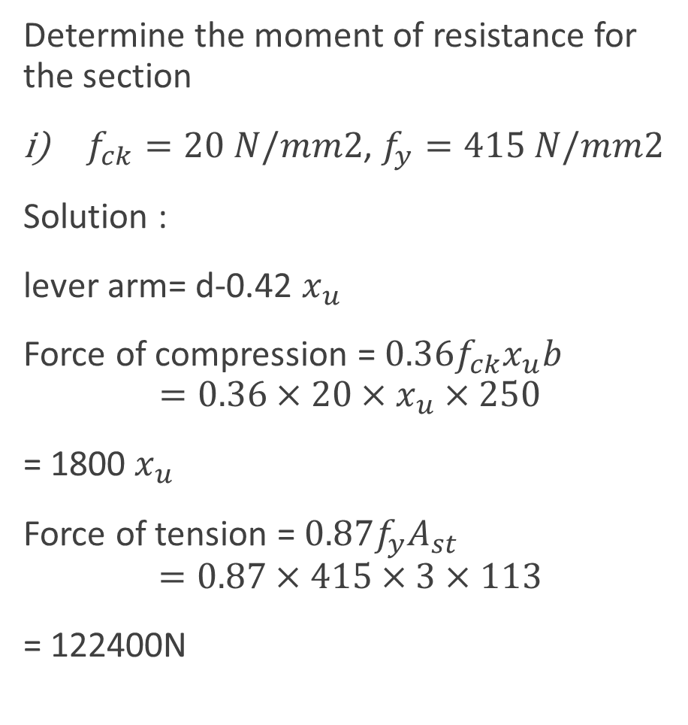
Determine the moment of resistance for the section
$f_{ck}=20 N/mm2$, $f_{y}=415 N/mm2$
Solution :
lever arm= d-0.42 $x_{u}$
Force of compression = $0.36f_{ck}x_{u}b$
$$=0.36×20×x_{u}×250$$
= 1800 $x_{u}$
Force of tension = $0.87f_{y}A_{st}$
$$=0.87×415×3×113$$
= 122400N
250
x
310
3-12Ø
40
$A_{st}=3×\frac{π}{4}×{12}^{2}$= 339

Slide 46
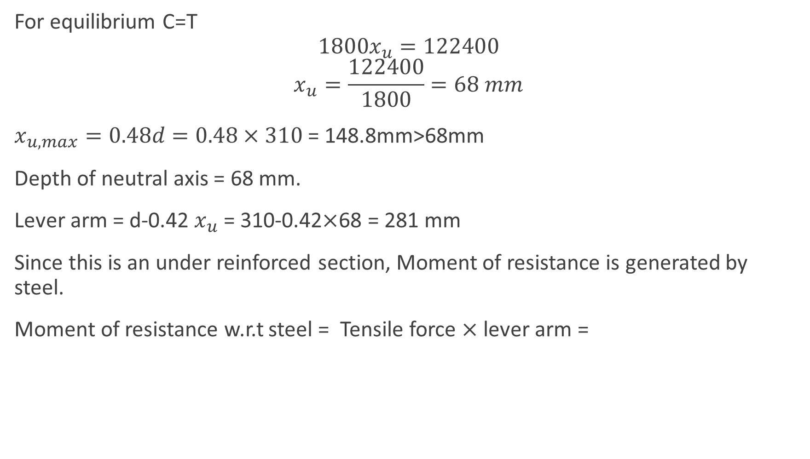
For equilibrium C=T
$$1800x_{u}=122400$$
$$x_{u}=\frac{122400}{1800}=68 mm$$
$x_{u,max}=0.48d=0.48×310$ = 148.8mm>68mm
Depth of neutral axis = 68 mm.
Lever arm = d-0.42 $x_{u}$ = 310-0.42$×$68 = 281 mm
Since this is an under reinforced section, Moment of resistance is generated by steel.
Moment of resistance w.r.t steel = Tensile force $×$ lever arm =

Slide 47
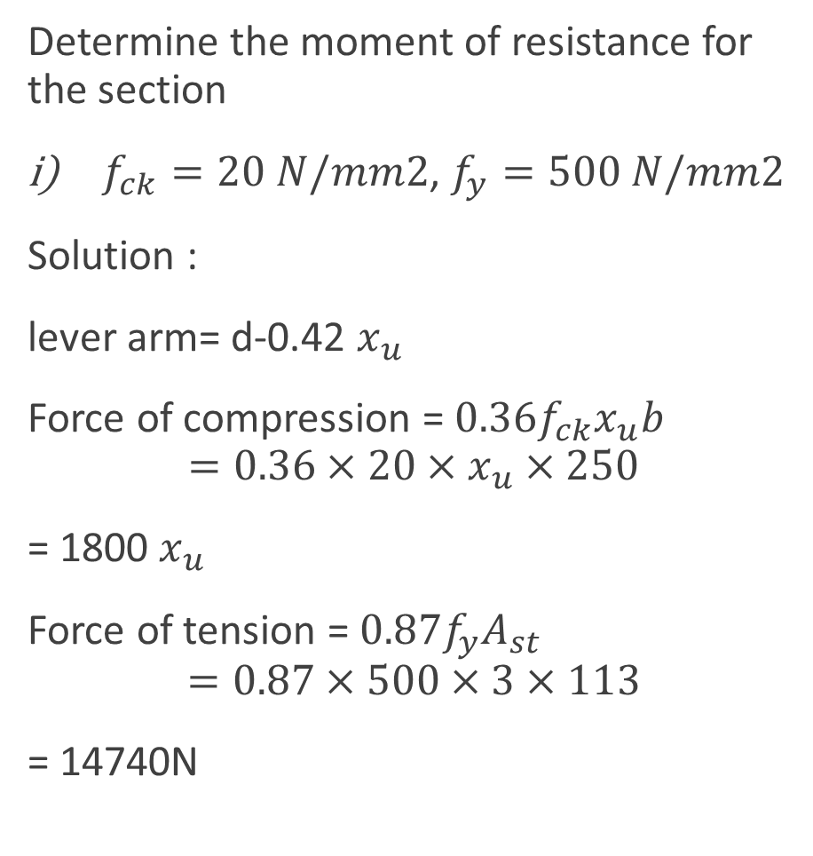
Determine the moment of resistance for the section
$f_{ck}=20 N/mm2$, $f_{y}=500 N/mm2$
Solution :
lever arm= d-0.42 $x_{u}$
Force of compression = $0.36f_{ck}x_{u}b$
$$=0.36×20×x_{u}×250$$
= 1800 $x_{u}$
Force of tension = $0.87f_{y}A_{st}$
$$=0.87×500×3×113$$
= 14740N
250
x
310
3-12Ø
40
$A_{st}=3×\frac{π}{4}×{12}^{2}$= 339

Slide 48
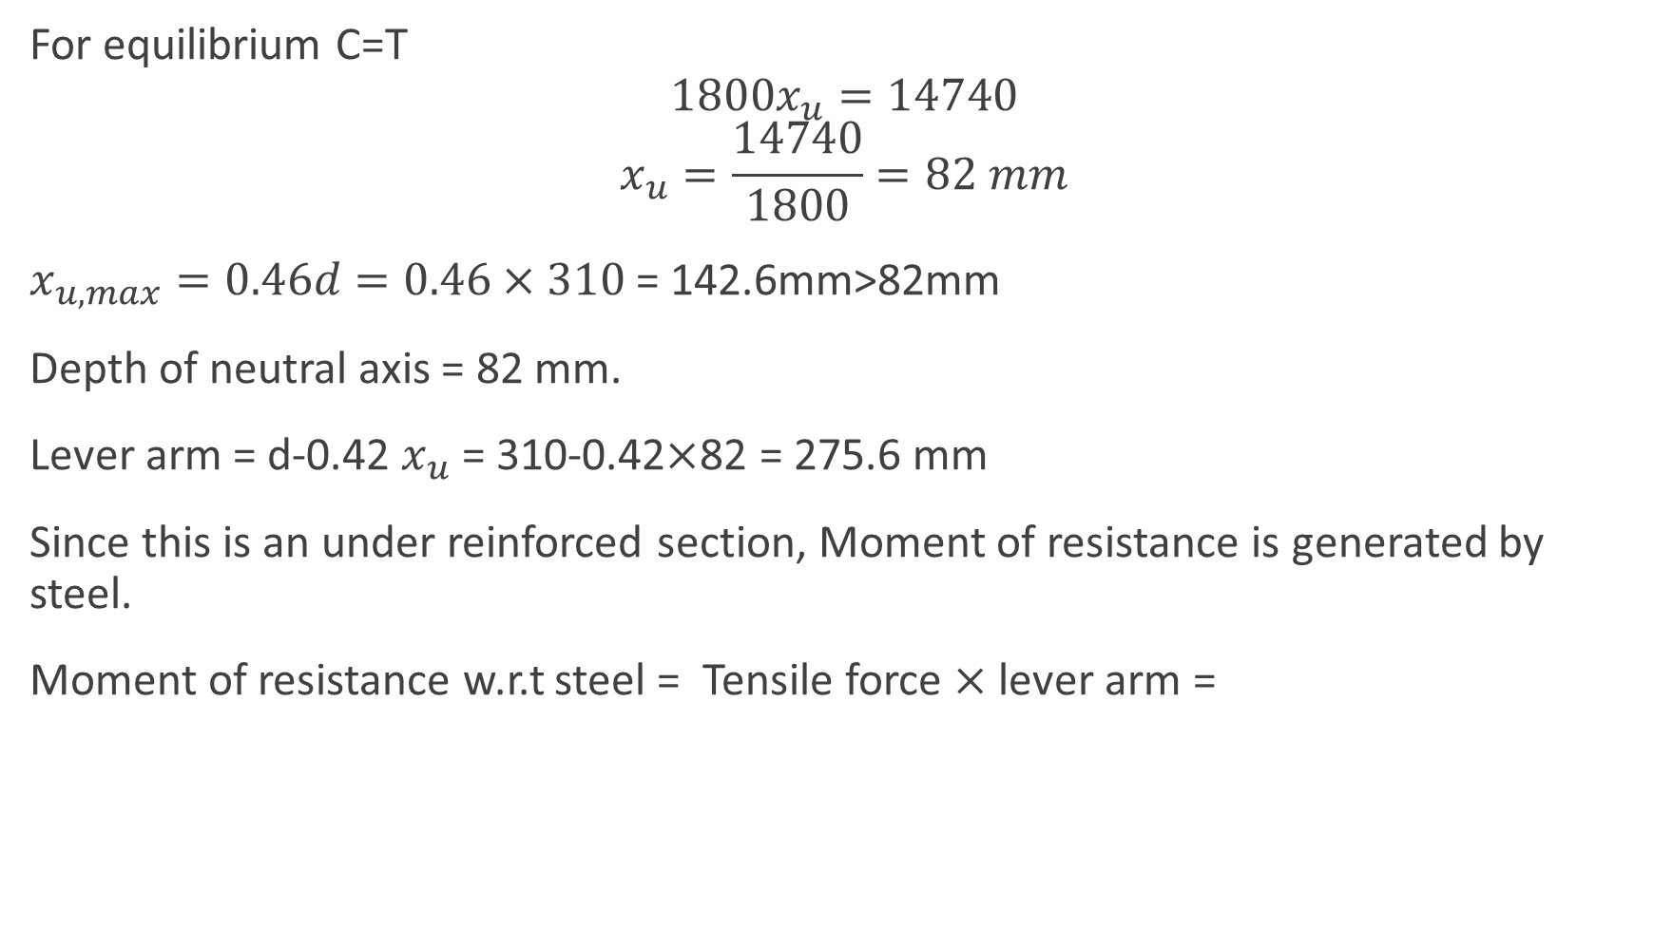
For equilibrium C=T
$$1800x_{u}=14740$$
$$x_{u}=\frac{14740}{1800}=82 mm$$
$x_{u,max}=0.46d=0.46×310$ = 142.6mm>82mm
Depth of neutral axis = 82 mm.
Lever arm = d-0.42 $x_{u}$ = 310-0.42$×$82 = 275.6 mm
Since this is an under reinforced section, Moment of resistance is generated by steel.
Moment of resistance w.r.t steel = Tensile force $×$ lever arm =

Slide 49
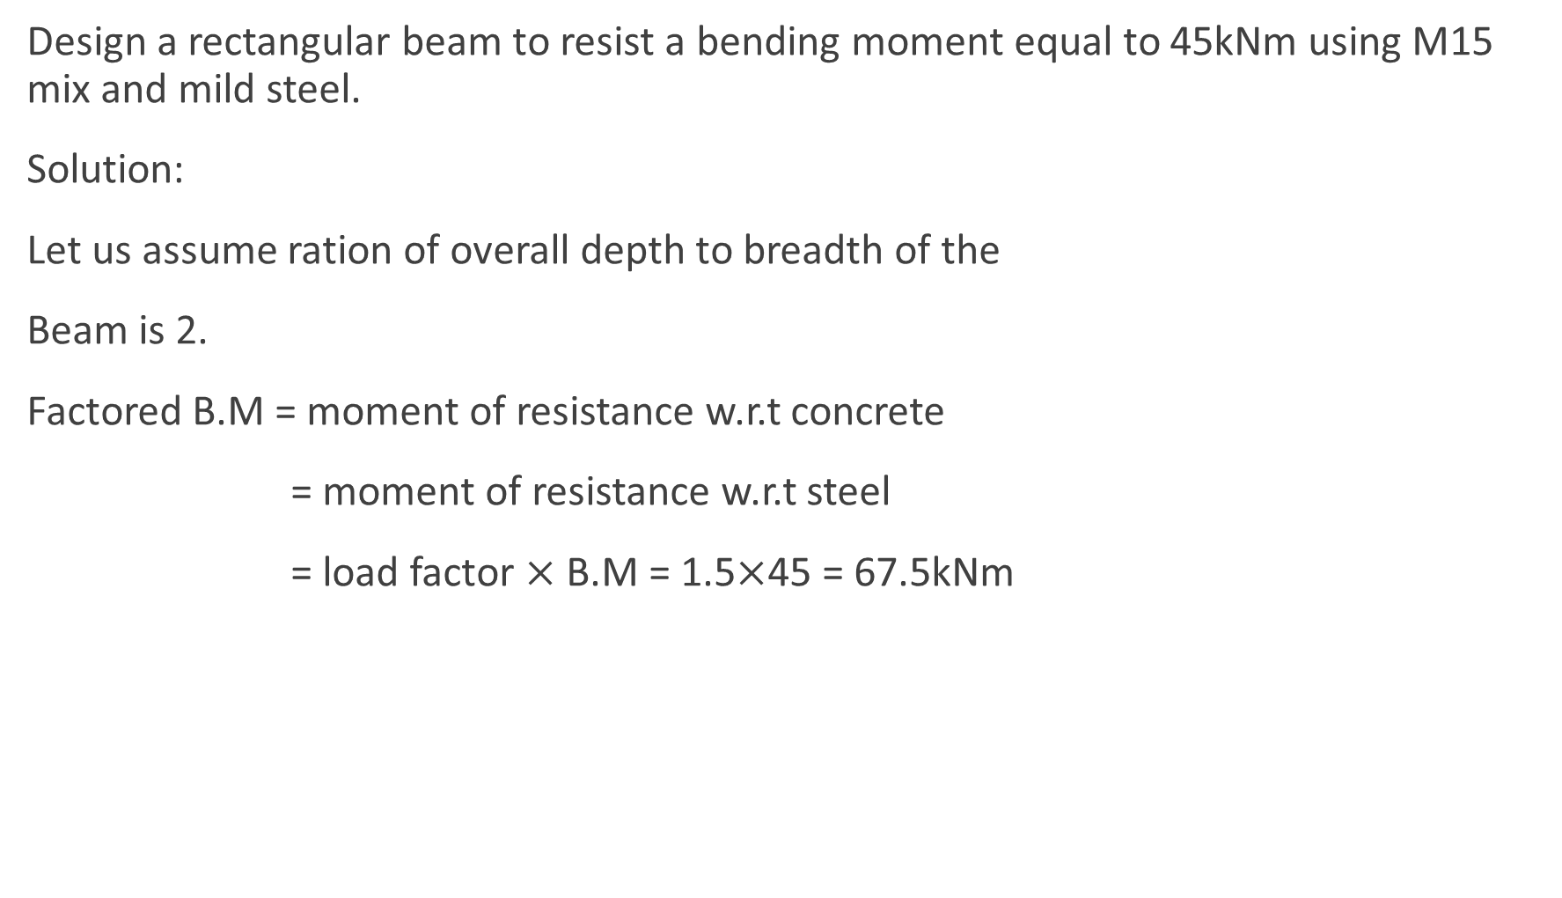
Design a rectangular beam to resist a bending moment equal to 45kNm using M15 mix and mild steel.
Solution:
Let us assume ration of overall depth to breadth of the
Beam is 2.
Factored B.M = moment of resistance w.r.t concrete
= moment of resistance w.r.t steel
= load factor $×$ B.M = 1.5$×$45 = 67.5kNm
b
x
d
dc

Slide 50
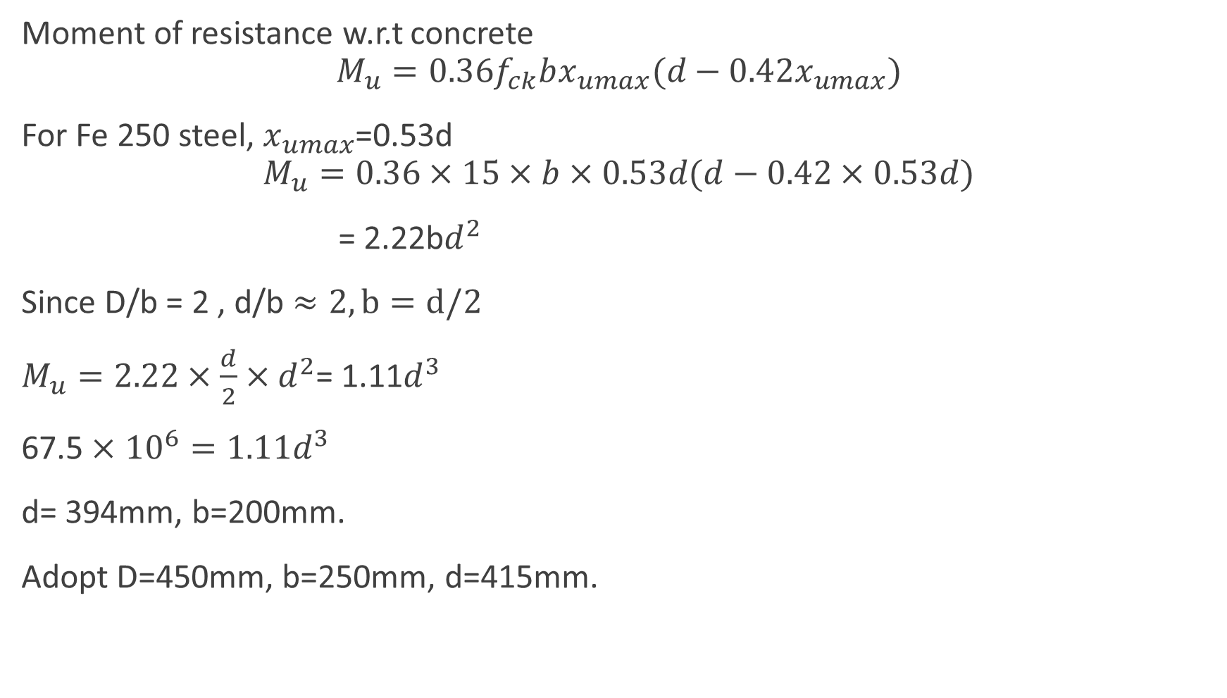
Moment of resistance w.r.t concrete
$$M_{u}=0.36f_{ck}bx_{umax}(d−0.42x_{umax})$$
For Fe 250 steel, $x_{umax}$=0.53d
$$M_{u}=0.36×15×b×0.53d(d−0.42×0.53d)$$
= 2.22b$d^{2}$
Since D/b = 2 , d/b $≈2, b=d/2$
$M_{u}=2.22×\frac{d}{2}×d^{2}$= 1.11$d^{3}$
67.5 $×$ ${10}^{6}=1.11d^{3}$
d= 394mm, b=200mm.
Adopt D=450mm, b=250mm, d=415mm.

Slide 51
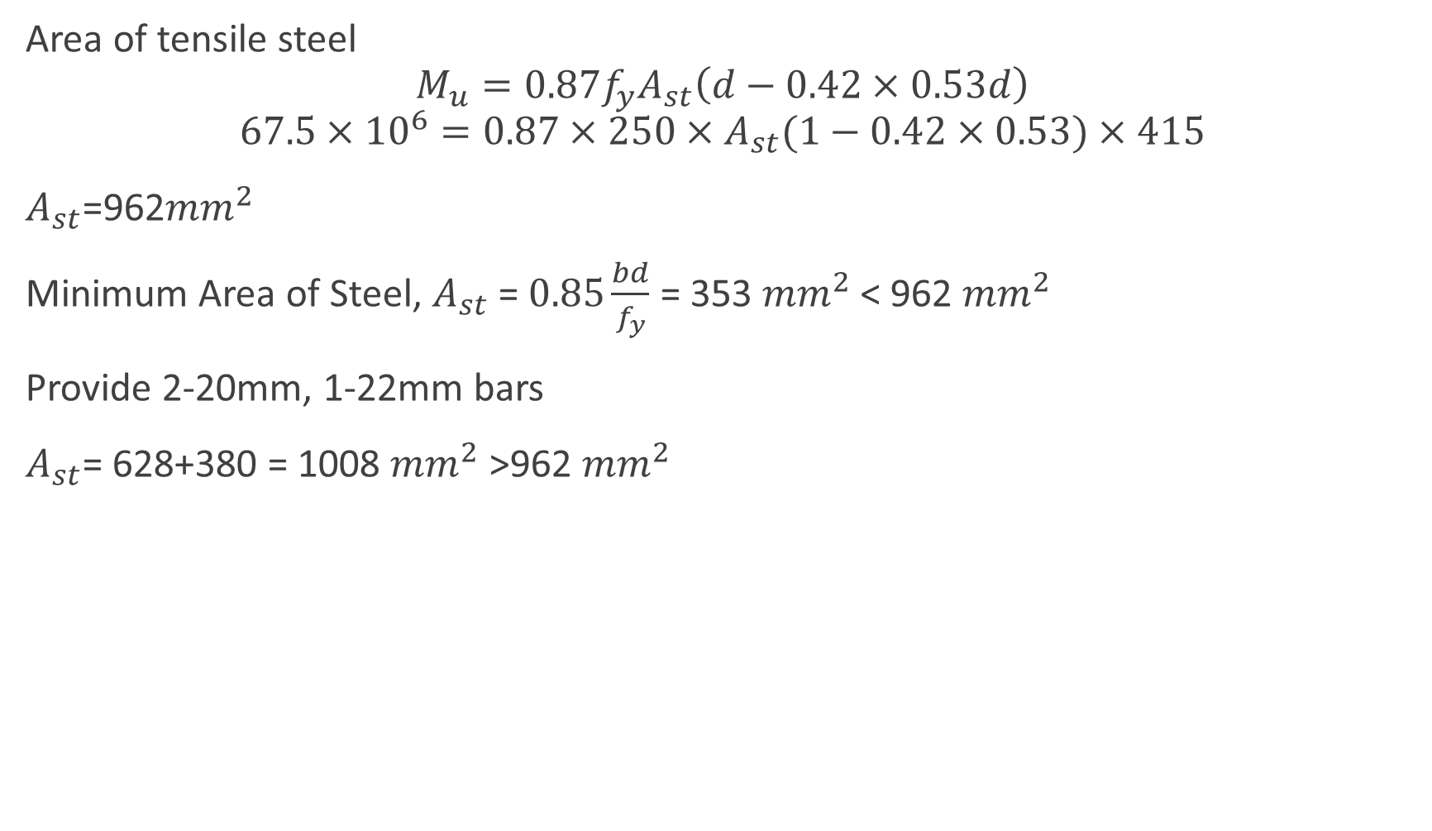
Area of tensile steel
$$M_{u}=0.87f_{y}A_{st}\left(d−0.42×0.53d\right)$$
$$67.5×{10}^{6}=0.87×250×A_{st}(1−0.42×0.53)×415$$
$A_{st}$=962${mm}^{2}$
Minimum Area of Steel, $A_{st}$ = $0.85\frac{bd}{f_{y}}$ = 353 ${mm}^{2}$ < 962 ${mm}^{2}$
Provide 2-20mm, 1-22mm bars
$A_{st}$= 628+380 = 1008 ${mm}^{2}$ >962 ${mm}^{2}$
250
x
415
35

Slide 52
Reinforced concrete structures
Unit – II
Limit State Design Method

Slide 53
Syllabus
INTRODUCTION TO LIMIT STATE DESIGN
Concept of limit state design
Characteristic loads
Characteristic strength
Partial load factor and material safety factors
Stress – Strain Curves
Assumptions
Stress Block Parameters
SINGLY AND DOUBLY REINFORCED BEAMS
Limit state analysis and design of Singly reinforced
and doubly reinforced beams.

Slide 54
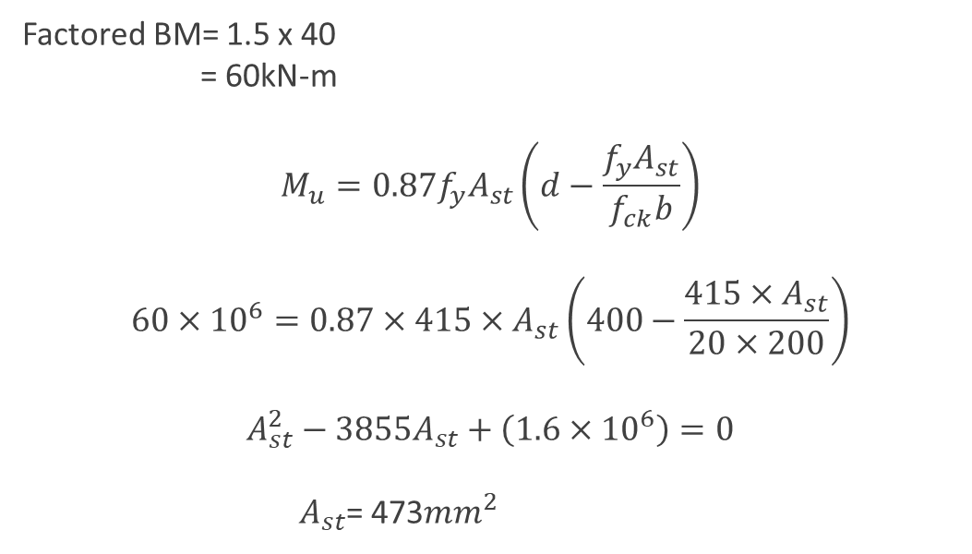
A rectangular beam is 200mm wide and 400mm deep upto the centre of reinforcement. Find the reinforcement required if it has to resist a moment of 40kN. Assume M20 mix and Fe415 grade steel.
200
Factored BM= 1.5 x 40
= 60kN-m
$$M_{u}=0.87f_{y}A_{st}\left(d−\frac{f_{y}A_{st}}{f_{ck}b}\right)$$
$$60×{10}^{6}=0.87×415×A_{st}\left(400−\frac{415×A_{st}}{20×200}\right)$$
$$A_{st}^{2}−3855A_{st}+\left(1.6×{10}^{6}\right)=0$$
$A_{st}$= 473${mm}^{2}$
400

Slide 55

Depth of neutral Axis
$$x_{u}=\frac{0.87f_{y}A_{st}}{0.36f_{ck}b}$$
$$=\frac{0.87×415×473}{0.36×20×200}$$
$$=118.6 mm$$
Limiting depth of neutral axis, $x_{umax}=0.48d$
= 0.48 $×$ 400
= 192 mm > 118.6 mm
The depth of neutral axis is 118.6 mm and the section is under reinforced section.
Hence use 2-16 mm and 1-12mm bar ($A_{st}$=515 ${mm}^{2}$> 473 ${mm}^{2}$)

Slide 56
Design a rectangular beam for 4m effective span which is subjected to a dead load of 15kN/m and a live load of 12kN/m. Use M15 mix and Fe 250 grade steel.
Solution:
For a simply supported beam,
Adopt L/d = 10
L= 4000mm and d=400mm
Adopt b=250mm, d=400mm, D = 450 mm
Density of Concrete = 25kN/m3.
Self weight of beam = 25 x 0.25 x 0.4 = 2.81 kN/m
Super imposed dead load DL = 15 kN/m
Super imposed live load LL = 12 kN/m
Total load = 2.81 + 15 + 12 = 29.81 kN/m

Slide 57

Factored load Wu = load factor x total load
= 1.5 x 29.81
= 44.72 kN/m
Maximum factored BM = $\frac{W_{u}l^{2}}{8}$
= 44.72 x 16/8 = 89.5 kN-m
For a balanced design, maximum depth of neutral axis
$$x_{u,max}=x_{u}$$
Factored Bending Moment = moment of resistance w.r.t concrete
89.5 x ${10}^{6}$ = $0.36f_{ck}bx_{u,max}(d−0.42x_{u,max}$)
89.5 x ${10}^{6}$= 0.36 x 15 x 250 x 0.53 d (d- 0.42 x 0.53d)
d = 402 mm

Slide 58

Force of Tension = force of compression
$$0.87f_{y}A_{st}=0.36f_{ck}bx_{u,max}$$
$$A_{st}=\frac{0.36×15×250×212}{0.87×250}$$
= 1315 mm2
Minimum area of tension steel
$$A_{st}=0.85\frac{bd}{f_{y}}$$
= 0.85 x $\frac{250×400}{250}$
= 340 mm2 < 1315 mm2
Maximum area of tension steel 4% of gross cross-sectional area = 4 x bD/100
= 0.04 x 250 x 450 = 4500 mm2 > 1315 mm2
Provide 3-25 mm bars giving total area of 1470 mm2 > 1315 mm2.

